Slide 1
Threads
Team Interrobang presents
By Hin Vong

Slide 2
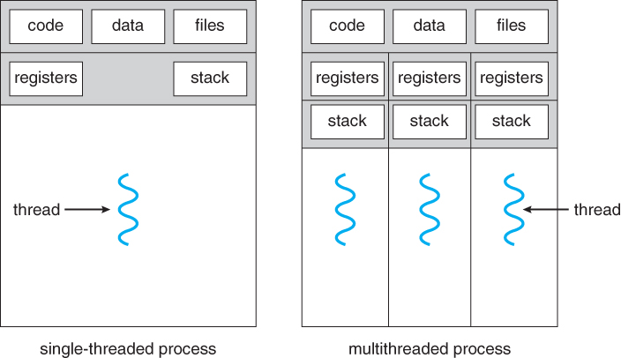
Overview

Slide 3
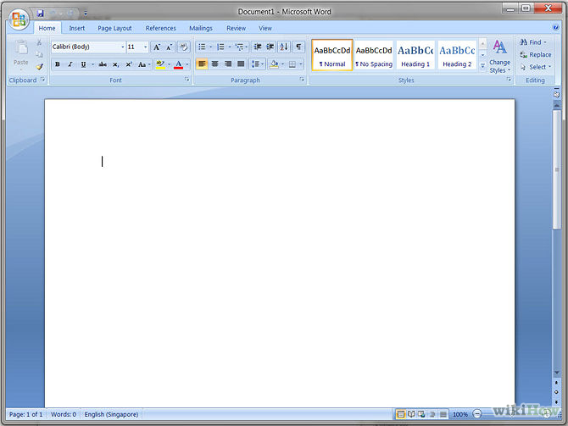
Benefits

Slide 4
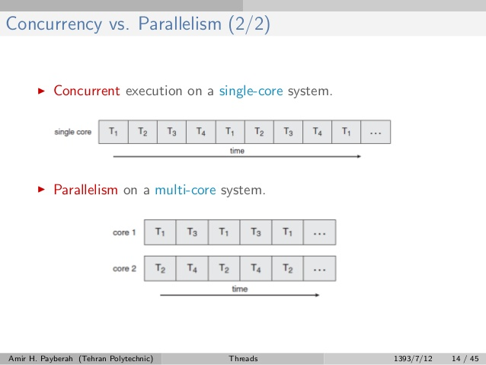
Multicore Programming

Slide 5



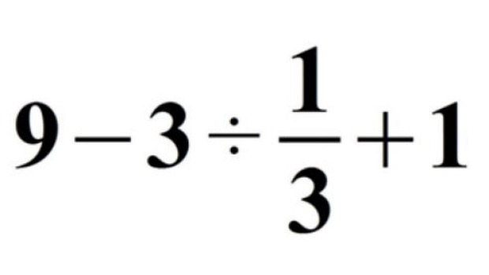
Challenges

Slide 6


Types of Parallelism
Data
Task

Slide 7
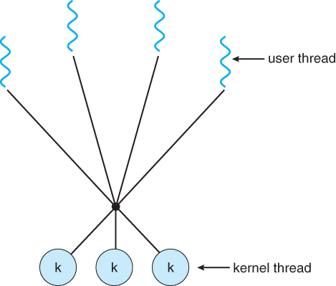
Many to Many

Slide 8
Thread counting
package com.myjava.threads;
class MyRunnableThread implements Runnable{
public static int myCount = 0;
public MyRunnableThread(){
}
public void run() {
while(MyRunnableThread.myCount < 10){
try{
System.out.println("Expl Thread: "+(++MyRunnableThread.myCount));
Thread.sleep(100);
} catch (InterruptedException iex) {
System.out.println("Exception in thread: "+iex.getMessage());
}
}
}
}
public class RunMyThread {
public static void main(String a[]){
System.out.println("Starting Main Thread...");
MyRunnableThread mrt = new MyRunnableThread();
Thread t = new Thread(mrt);
t.start();
while(MyRunnableThread.myCount < 10){
try{
System.out.println("Main Thread: "+(++MyRunnableThread.myCount));
Thread.sleep(100)
} catch (InterruptedException iex){
System.out.println("Exception in main thread: "+iex.getMessage());
}
}
System.out.println("End of Main Thread...");
}
}

Slide 9
Starting Main Thread...
MainThread Thr: 1
OtherThead Thr: 2
MainThread Thr: 3
OtherThread Thr: 4
MainThread Thr: 5
OtherThread Thr: 6
MainThread Thr: 7
OtherThread Thr: 8
MainThread Thr: 9
OtherThread Thr: 10
End of Main Thread...

Slide 10
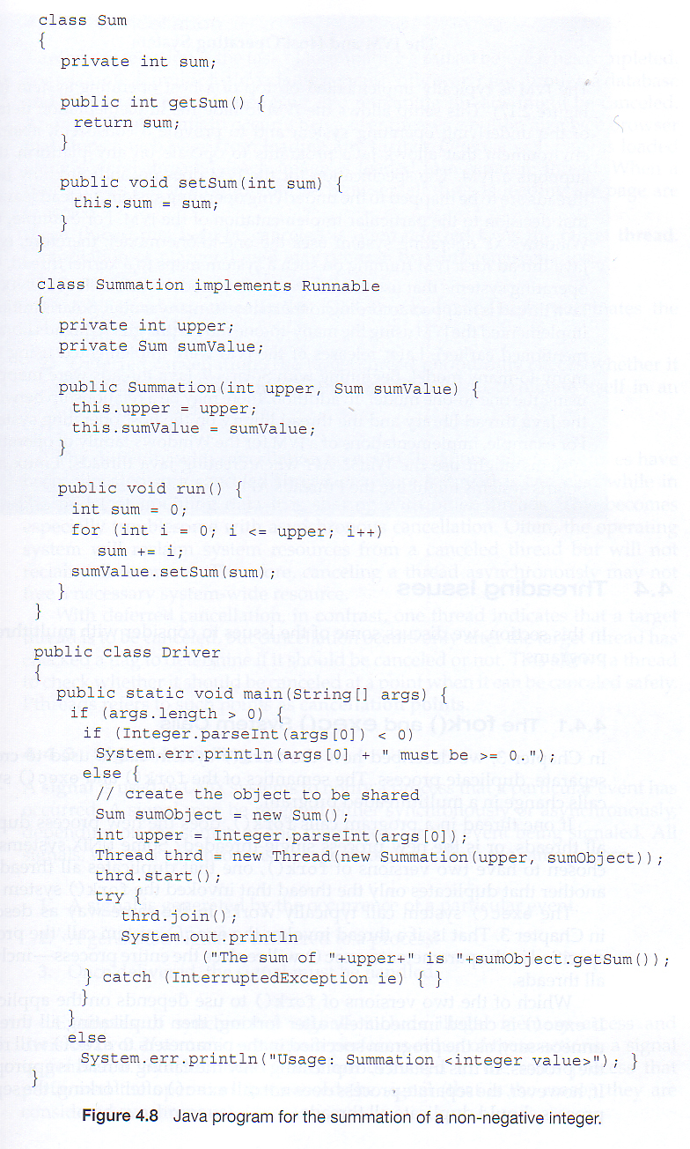
Java Threads

Slide 11
Task Scheduling
By David Chau
Notes:
Threading -> Process Scheduling -> Memory -> Storage -> File Systems

Slide 12
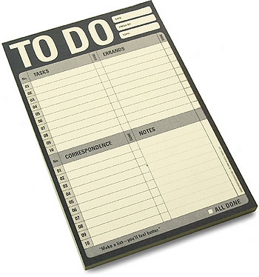
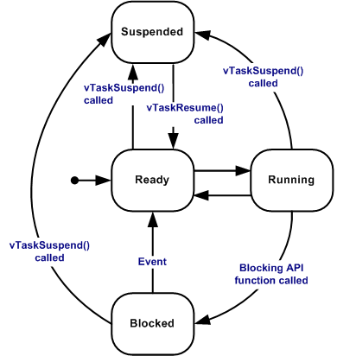
What is Task Scheduling?

Slide 13
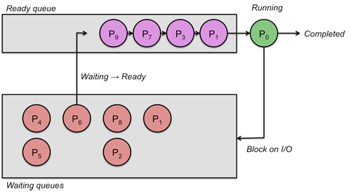
First Come First Serve

Slide 14
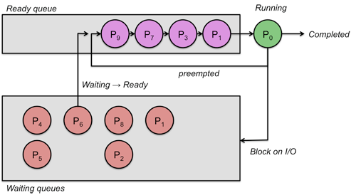
Round Robin

Slide 15
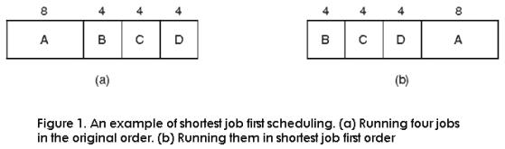
Shortest Job First

Slide 16

Priority Scheduling

Slide 17
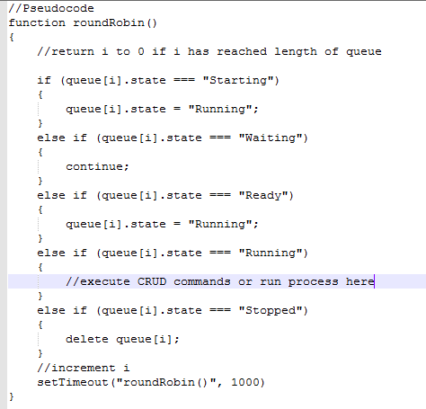
Real Life Scheduling Example
Notes:
Coding example

Slide 18




How do we choose?

Slide 19
Memory Management
Andrew Goff

Slide 20
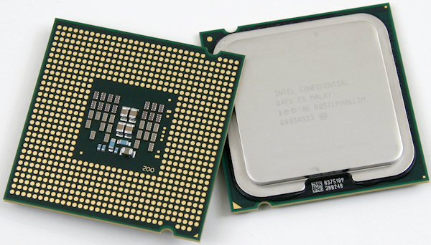

Slide 21
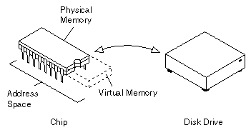

Slide 22
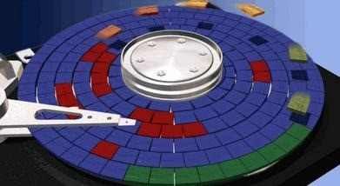

Slide 23
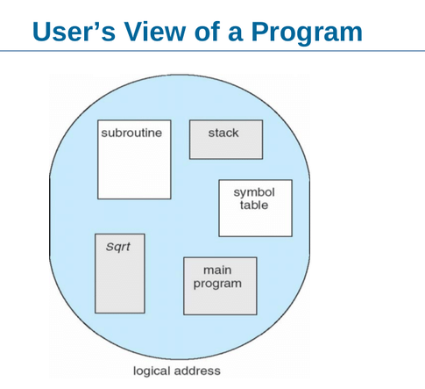

Slide 24
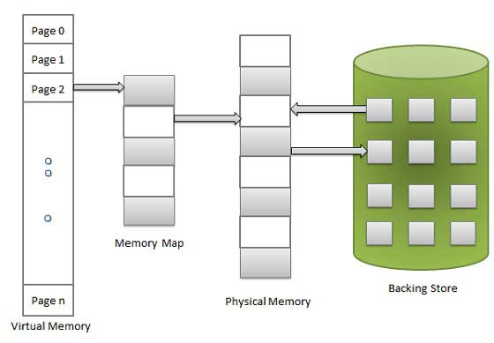

Slide 25
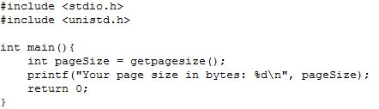

Slide 26
Storage
By Tony Tran

Slide 27
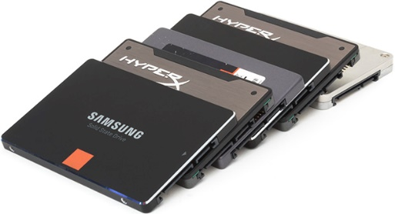
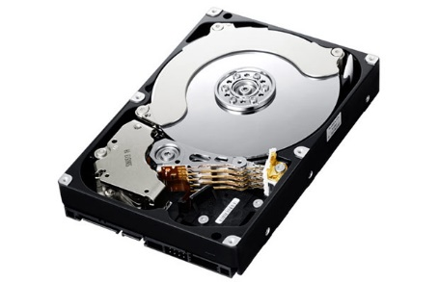
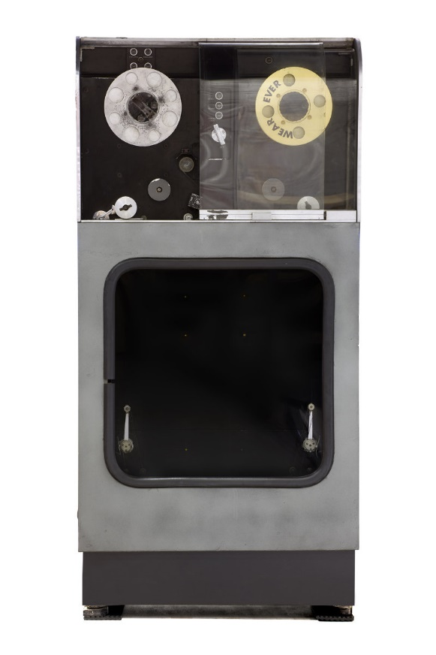
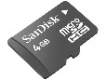

Storage Devices
1951
Today
First Computer Hard Disk
Model: UNISERVO

Slide 28
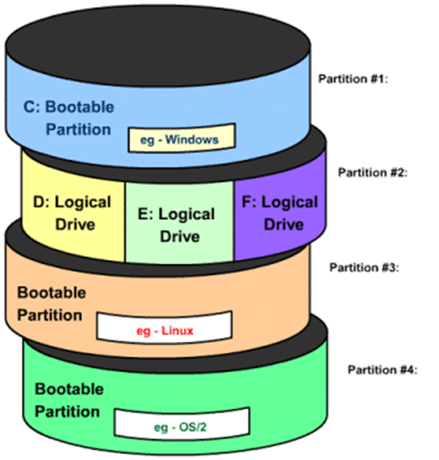

Partitions & Files
IndexedDB

Slide 29
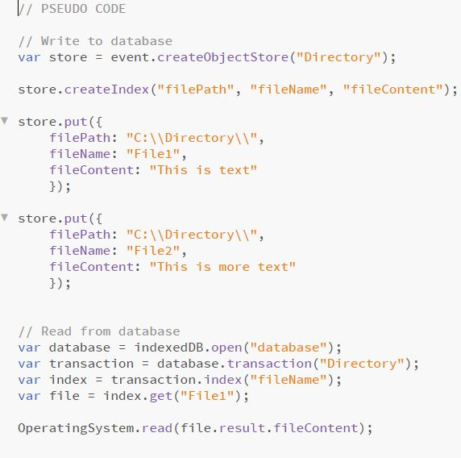
IndexedDB

Slide 30

FILE SYSTEMS Hao Xian Zheng

Slide 31
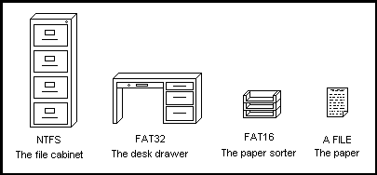
FILE ORGANIZATION

Slide 32
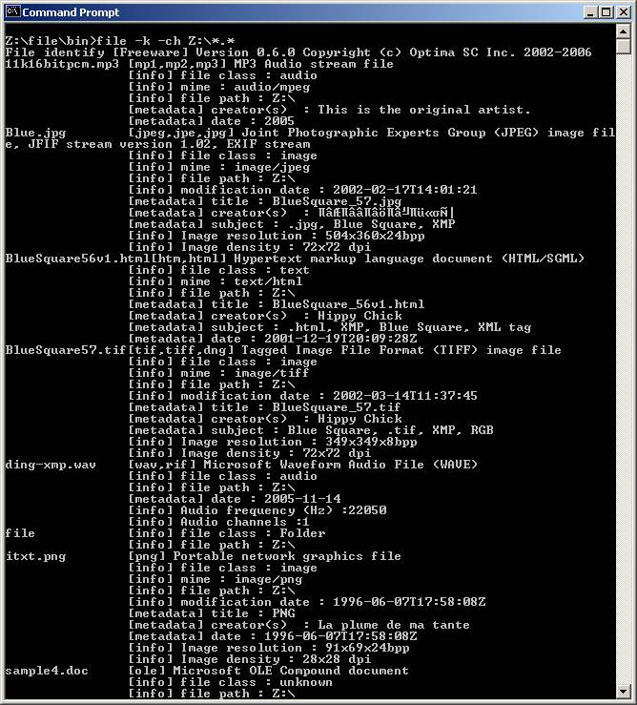
File Attributes

Slide 33
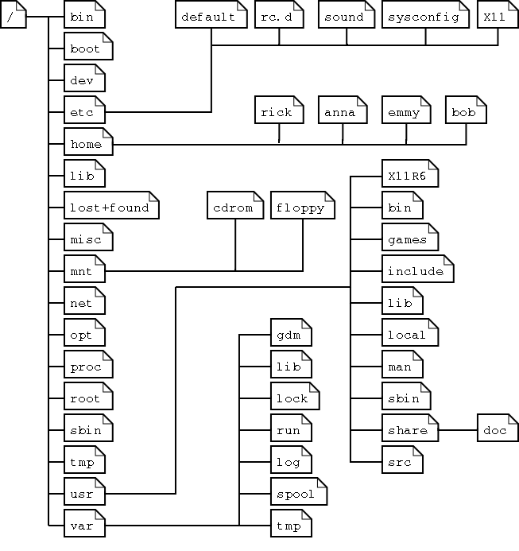
FILE STRUCTURE

Slide 34
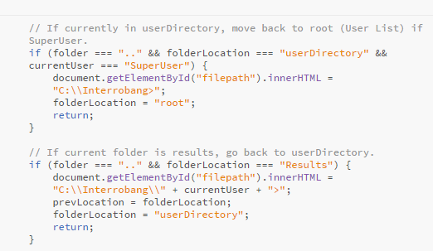
Code

